Slide 1
Geotechnical conditions for the construction of the Vršnik Tunnel on the Niš–Priština Highway
8th International conference: Contemporary achievements in civil engineering, Subotica, Srbija, 2021.
Marinković, N.,MSc Civ. Eng., MSc Eng. Geol., University of Niš,
Jovanovski, M., PhD, Full Prof., University "Ss. Cyril and Methodius" of Skopje
Zlatanović, E., PhD, Assist. Prof., University of Niš,
Bonić, Z., PhD, Assoc. Prof., University of Niš,
Romić, N., MSc Civ. Eng., University of Niš.

Slide 2
INTRODUCTION
The total length of the highway route is 77 km, along which the construction of numerous important objects (58) is planned, including six tunnels.
The Vršnik Tunnel is 200m long.
The ground level in the area of the entrance portal is 336 m and in the area of the exit portal is 345 m, whereas the highest ground level above the tunnel pipe is about 351 m.
The construction of two tunnel pipes is envisaged at the central distance between the axes of the tunnel pipes of about 37.5 m.
The pavement structures in the tunnel are designed with a grade of 4%.
The height of the tunnel in relation to the pavement structure is about 7.8 m

Slide 3
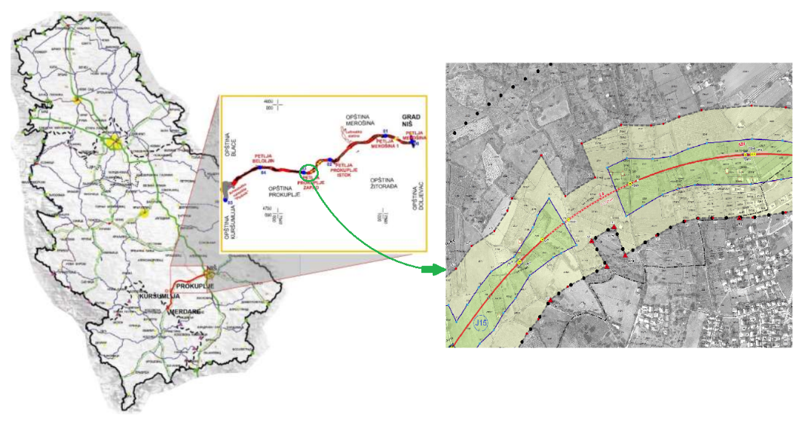
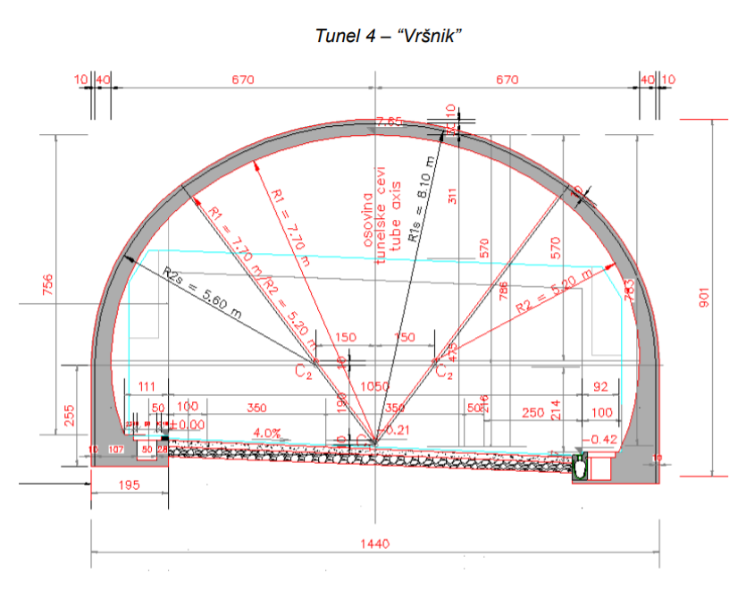
Highway route with characteristic details on the section Niš–Pločnik

Slide 4
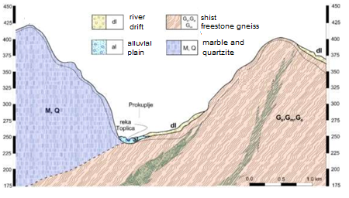
GEOLOGICAL PROPERTIES OF THE TERRAIN
Based on the test, the profile of the characteristic cross-section of the area in which the construction of the tunnel is planned is presented.
A characteristic engineering–geological cross-section of a shist complex

Slide 5
METHODOLOGY FOR THE PREDICTION OF GEOTECHNICAL CONSTRUCTION CONDITIONS
For the needs of preparing the Survey of geotechnical conditions for the tunnel construction at the level of the Final Design, additional exploration holes were drilled and related geophysical investigations were performed.
The dynamic properties of rock masses are interpreted based on the measured velocities of longitudinal (Vp) and transverse seismic waves (Vs), which were used to determine characteristic dynamic parameters.
The obtained results define the following zones according to the seismic wave velocity parameter:
1. Surficial zone with values: Vp < 200–750 m/s, Vs < 80–280 m/s, with the thickness from 1 to 4 m;
2. Subsurface zone, which would match to the weathering crust with values: Vp < 800–1580 m/s and Vs = 300–590 m/s, with the thickness of 8 to 11 m;
3. Quite degraded gneisses with values: Vp = 1600–1900 m/s; Vs = 600–700 m/s;
4. Degraded cracked gneisses with values: Vp = 1900–2200 m/s; Vs = 700–800 m/s.

Slide 6
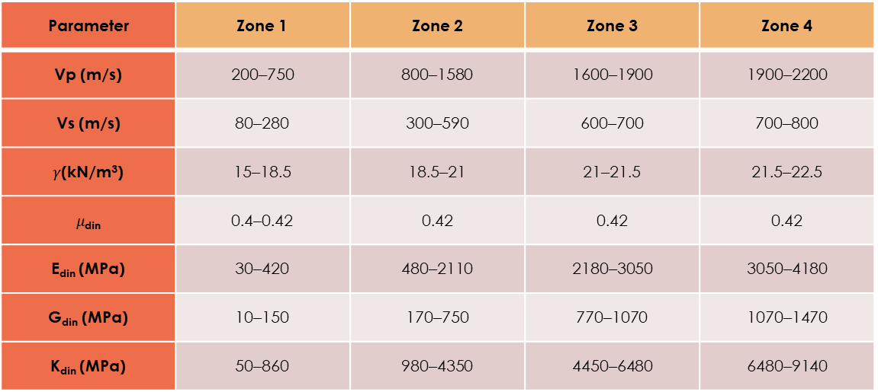
Separated zones based on geophysical seismic investigations
Parameter | Zone 1 | Zone 2 | Zone 3 | Zone 4
Vp (m/s) | 200–750 | 800–1580 | 1600–1900 | 1900–2200
Vs (m/s) | 80–280 | 300–590 | 600–700 | 700–800
$γ$(kN/m³) | 15–18.5 | 18.5–21 | 21–21.5 | 21.5–22.5
$μ$_{din} | 0.4–0.42 | 0.42 | 0.42 | 0.42
E_{din} (MPa) | 30–420 | 480–2110 | 2180–3050 | 3050–4180
G_{din} (MPa) | 10–150 | 170–750 | 770–1070 | 1070–1470
K_{din} (MPa) | 50–860 | 980–4350 | 4450–6480 | 6480–9140
Selected zones with prognosis length
No. | Chainage (approximately) [km] | Description
1. | 19+550 – 19+590 | Entrance portal of the tunnel section to the zone of layer height up to about 10 m, V category according to RMR
2. | 19+590 – 19+665 | IV category according to RMR
3. | 19+665 – 19+730 | Section with often changes between IV and III category according to RMR
4. | 19+730 – 19+750 | Exit portal of the tunnel section to the zone of layer height up to about 15 m, V to IV category by RMR

Slide 7
APPLIED METHODOLOGY FOR EXTRAPOLATION OF PARAMETERS AT THE LEVEL OF ROCK MASS
Methodology based on a combination of rock mass classification parameters was applied using the methods RMR, Q system, and GSI system.
 | RMR | Q
Portal zone of tunnel sections 1 and 2 | 6–10 | 0,008
Zone 2 i 4 | 20–25 | 0,165
Zone 3 | 32–37 | 0,624
The range of values of the GSI parameter is defined within the following limits:
- Degraded and cracked gneiss: 17–26;
- Fractured, cracked, and less decomposed gneiss: 26–40;
- Weakly cracked gneiss: 40–55.

Slide 8
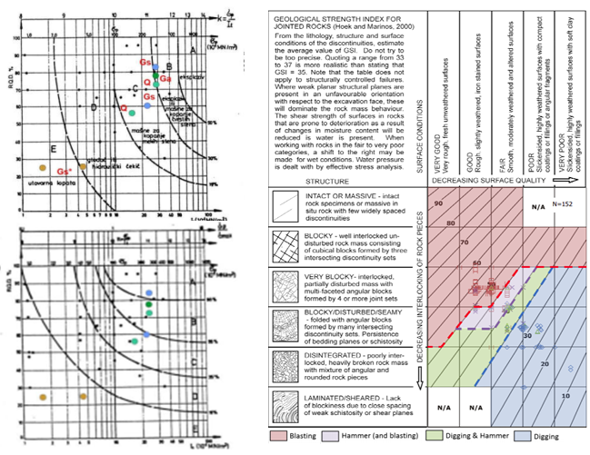
PREDICTION OF GEOTECHNICAL CONDITIONS OF TUNNEL CONSTRUCTION
For prediction of the excavation method, as well as for defining the method of tunnelling and protection of the excavation, it was performed a classification of the terrain as a working environment – the Louis' method (left), as well as a somewhat newer method based on the GSI value, were used (right).

Slide 9
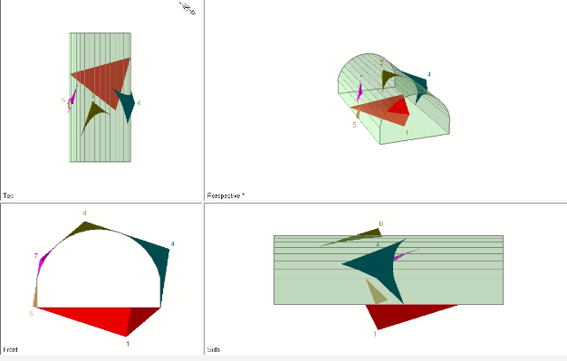
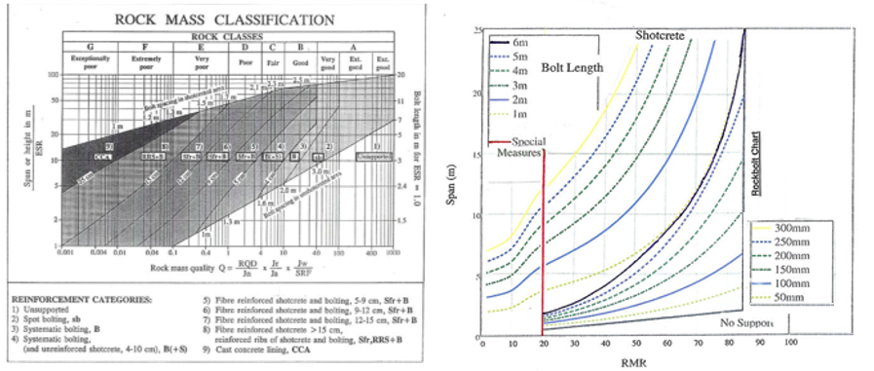
The analysis of possible special cases of instability was carried out using the UNWEDGE software (Figure left).
To select a support system, in the first iteration, the design engineer can use the recommendations of Barton or Bienawski, or diagrams presented in Figure right.

Slide 10
CONCLUSION
The Vršnik Tunnel consists of two tunnel pipes.
The construction is performed mostly in gneisses and degraded gneisses.
The finished road level is inclined by 4.0% towards the entrance portal.
During the construction of the tunnel, the application of contemporary tunnel construction technology is predicted - the concept of the NATM.
For geotechnical conditions of the construction of the tunnel it can be concluded that they are favourable within Zone 2, which covers approximately 65% of the length of the tunnel.
The Zone 4 is assessed conditionally (relatively) favorable (about 15%), whereas for the remaining part of the tunnel more difficult construction conditions are expected.
Such difficult conditions are expected primarily at the part in the approach cutting areas and at the portal sections of the tunnel with a small overburden height.
It is necessary, in accordance with all the above stated, to adapt excavation technology, support systems, and appropriate drainage measures.

Slide 11
REFERENCES
Group of authors, (2018). Infrastructure Project Facility – Technical Assistance 4 (IFP4) - TA2012054 R0 WBF RO WBF Preliminary Design and Feasibility Study with ESIA for construction of Highway E-80 in Serbia (SEETO Route 7) PRELIMINARY DESIGN - Environmental and Social Impact Assessment Study (ESIA).
Rakić, D. et al..: Engineering-geological conditions for the construction of the first section of niš-pločnik highway, 2018, p.p. 12-23.
Infrastructure Project Facility – Technical Assistance 4 (IFP4) - TA2012054 R0 WBF.
Spirovski, D., Jovanovski, M.: Study for geotechnical conditions for the construction of the Vršnik tunnel, Geotehnika Nova, Skopje, 2020.
Barton, N.: Some new Q-value correlations to assist in site characterisation and tunnel design. International Journal of Rock Mechanics &amp; Mining Sciences, vol. 39, 2002, p.p. 85-216.
Jovanovski, M. Methodology for deteremination of rock masses as a working media, Doctoral Thesis, University "Ss. Cyril and Methodius" of Skopje, Faculty of Civil Engineering, Skopje, Macedonia, 2001.
Chaniotis, N., Saroglou, H, Tsiambaos, G: Excavatability of rockmasses in tunnelling, 7th International Symposium on Tunnels and Underground Structures in SEE 2017, May 3-5, 2017, Zagreb, Croatia.

Slide 12
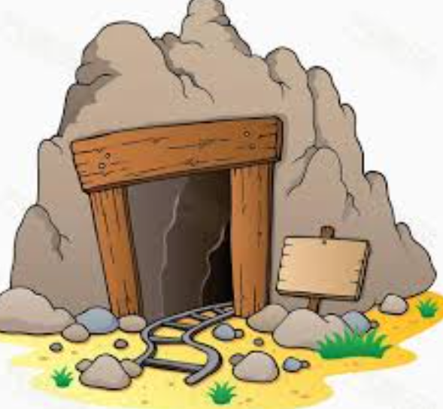
Thank you for attention!

